Slide 1
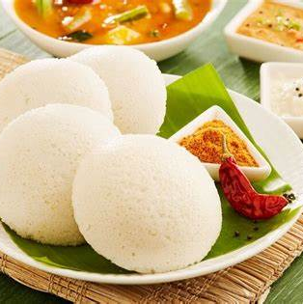
Inverse Cooking:
Recipe Generation from Food Images
Asst.Prof Husain Ahamed P
Anusree Jnanakrishnan

Slide 2
INDEX
Introduction
Problem Definition
Methodology
Feasibility Analysis
Conclusion
Reference

Slide 3
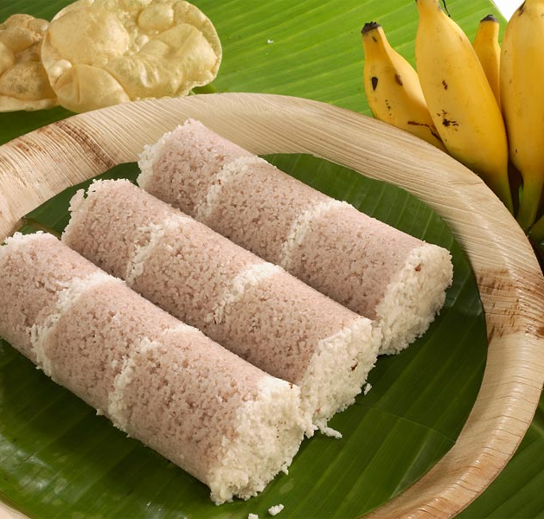
INTRODUCTION

Slide 4



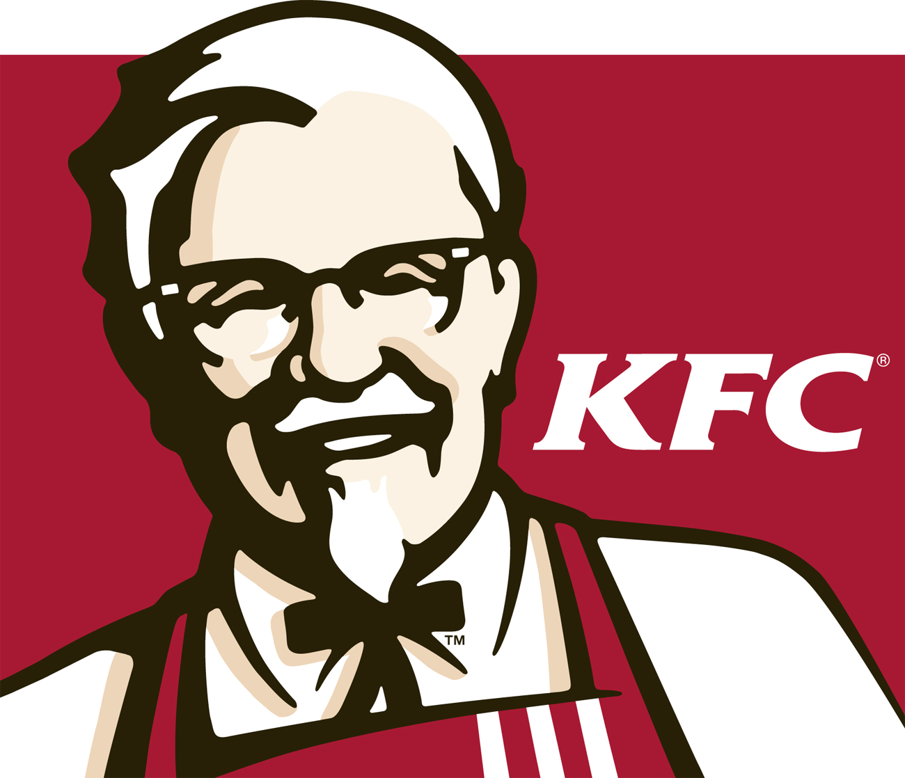
Food is fundamental to human existence. Not only does it provide us with energy—it also defines our identity and culture. many people sharing pictures of food they are eating across social media.
In the past, food was mostly prepared at home, but now a days we frequently consume food prepared by third parties.
By simply looking at a food image we do not have access to its preparation process. We do not know the ingredients and the recipe of our favorite food also.
Cooking is business also. There is Amul, KFC ,Dominos, Nestle, etc. are popular brands and Zomato, Swiggy are food services.
We eat different foods which is in different color , texture and prepared by complex process. How many of us know the ingredients used in these foods and how to prepare them. Some people who are interested in cooking will find out by searching Google and checking YouTube etc.
But in case if you do not know the name of the food but you are attracted by its taste and other factors how will you find out which food you are looking for and how to prepare that food.
Snap a photo of a particular dish and, within seconds, the system can analyze the image and generate a recipe with a list of ingredients and steps needed to create the dish.

Slide 5
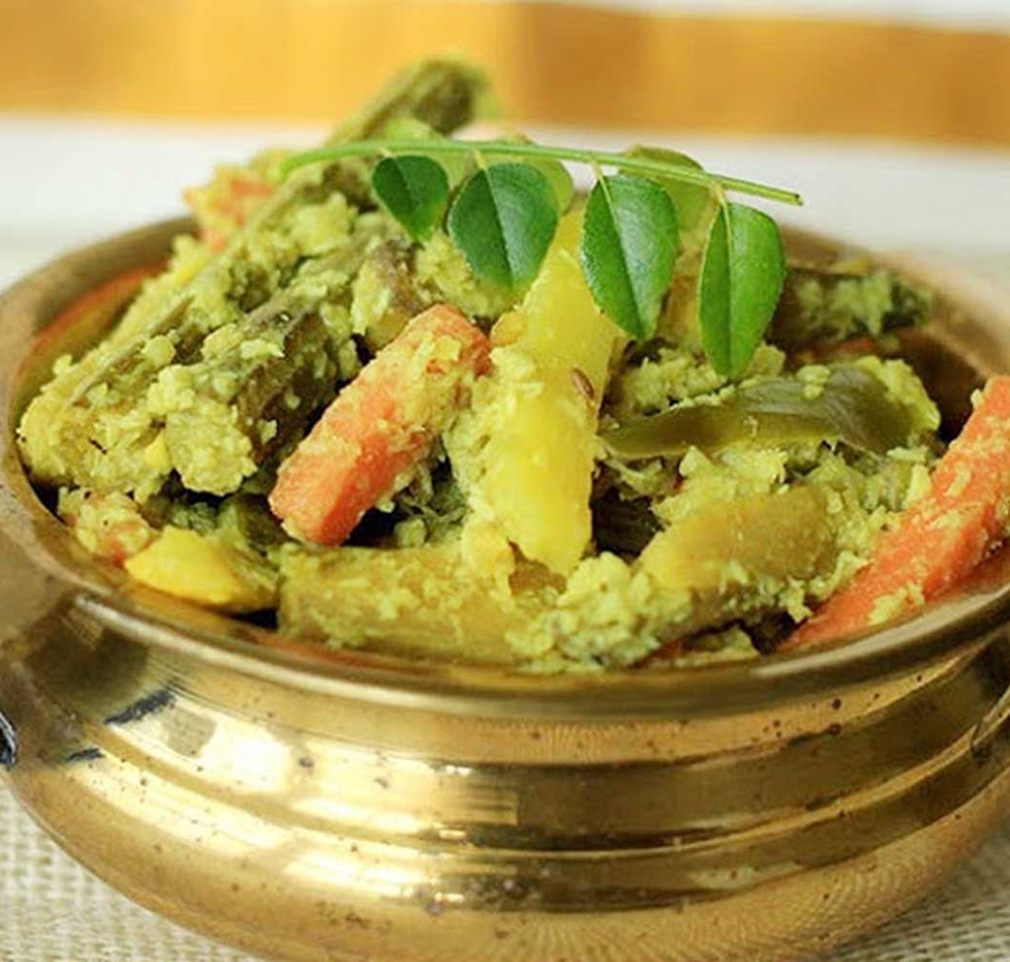
Problem definition

Slide 6
Inverse Cooking : Recipe Generation from food images an AI based approach.
The Recipe generated are mainly focused on Kerala special dishes such as Aviyal, Sambar, Payasam, Dhosa , etc.
These items represents our food culture and with the help of inverse cooking we can access the preparation process by simply taking the picture of the food item.
This poses additional challenges, as food components have high intra-class variability, heavy deformations occur during cooking, and ingredients are frequently occluded in a cooked dish. Our system is a first step toward broader food understanding systems such as calories estimation and recipe creation.

Slide 7
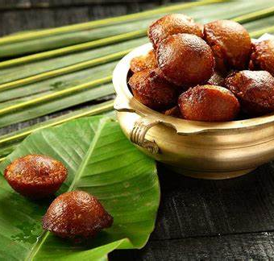
METHODOLOGY

Slide 8
Generating a recipe from an image requires a simultaneous understanding of the ingredients composing the dish as well as any processing they went through, e.g., slicing, or blending with other ingredients.
Traditionally, the image-to-recipe problem has been formulated as a retrieval task, where a recipe is retrieved from a fixed dataset based on the image similarity score in an embedding space.
The performance of such systems highly depends on the dataset size and diversity, as well as on the quality of the learned embedding.
Not surprisingly, these systems fail when a matching recipe for the image query does not exist in the static dataset.

Slide 9
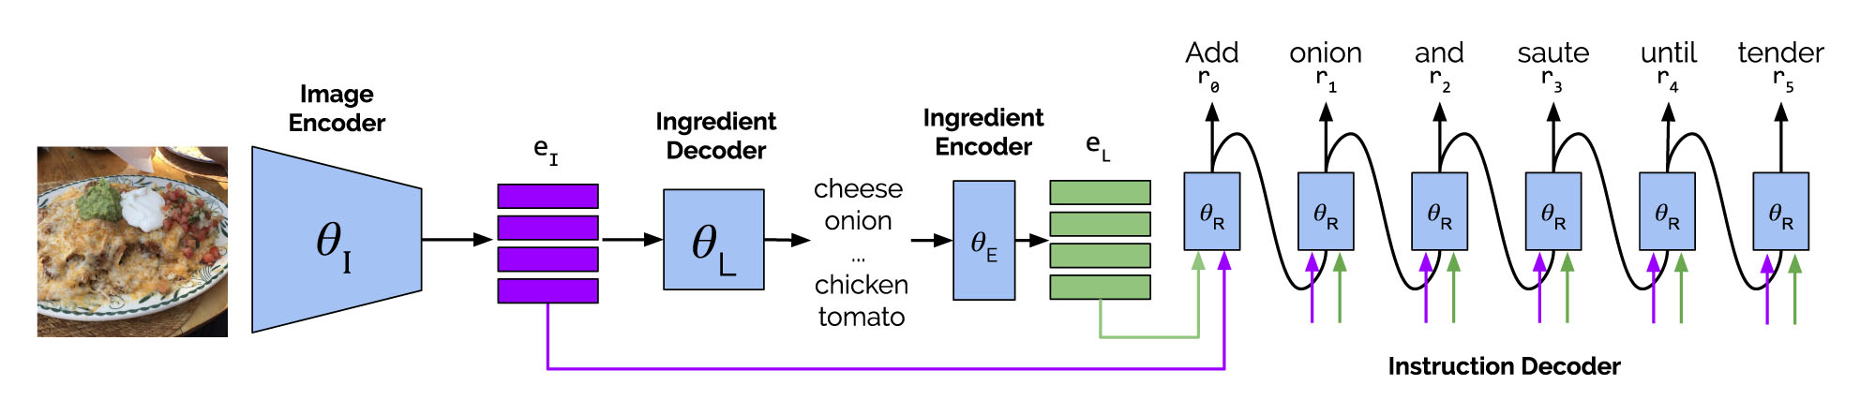
Our image-to-recipe generation system takes as input a food image and outputs a recipe containing title, ingredients, and cooking instructions.
Our method starts by pretraining an image encoder and an ingredients decoder, which predicts a set of ingredients by exploiting visual features extracted from the input image and ingredient co-occurrences.
Then we train the ingredient encoder and the instruction decoder, which generate title and instructions by taking the image’s visual features and the predicted ingredients and feeding them into a state-of-the-art sequence generation model.

Slide 10
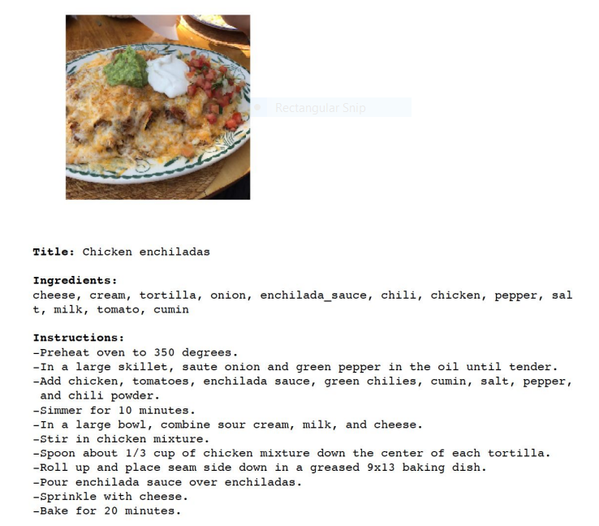
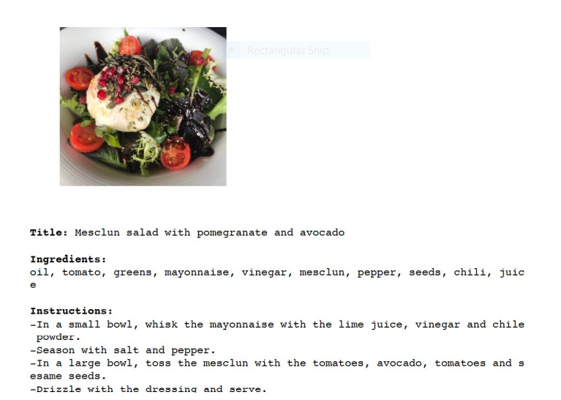

Slide 11
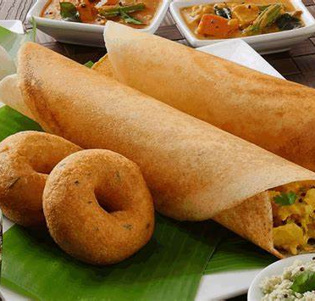
FEASIBILITY ANALYSIS

Slide 12
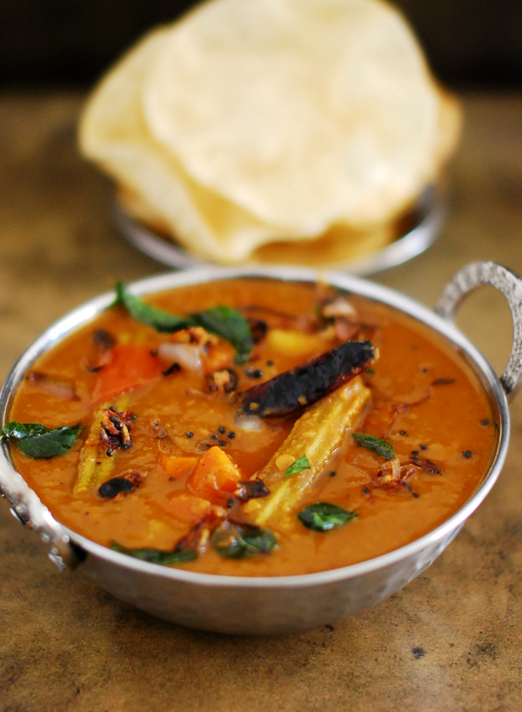
This project technically and economically feasible.
It requires Python 3.6 and PyTorch 0.4.1 cuda version 1.0
Expected to complete in about 4 weeks.

Slide 13
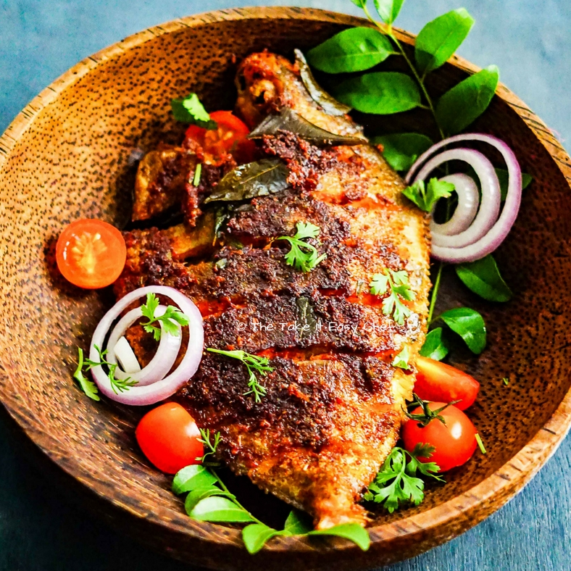
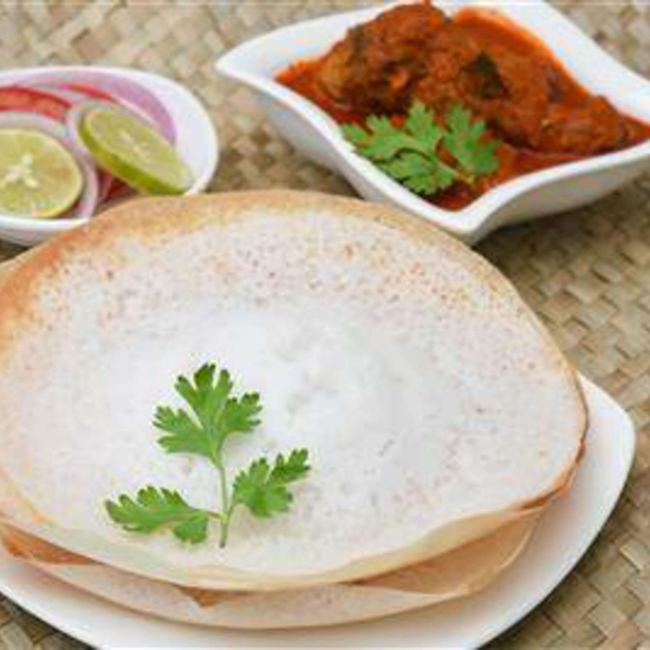
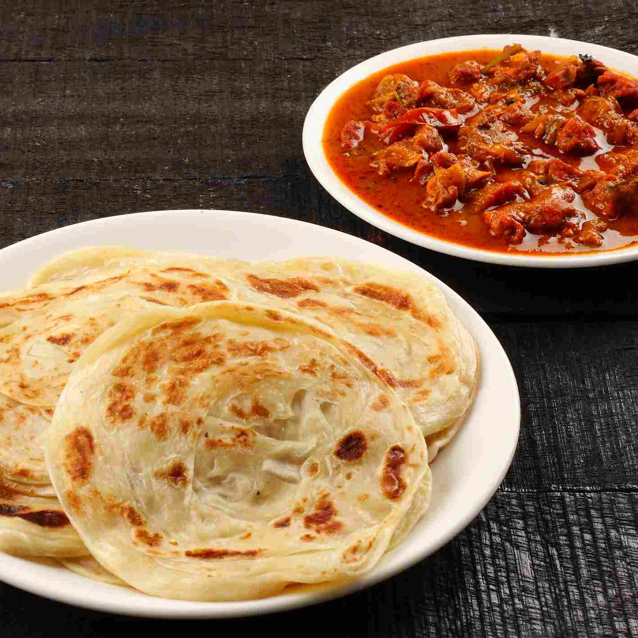
CONCLUSION
In this paper, we introduced an image-to-recipe generation system, which takes a food image and produces a recipe consisting of a title, ingredients and sequence of cooking instructions.
We first predicted sets of ingredients from food images, showing that modeling dependencies matters. Then, we explored instruction generation conditioned on images and inferred ingredients, highlighting the importance of reasoning about both modalities at the same time.

Slide 14
Inverse Cooking: Recipe Generation From Food Images | IEEE Conference Publication | IEEE Xplore
References

Slide 15
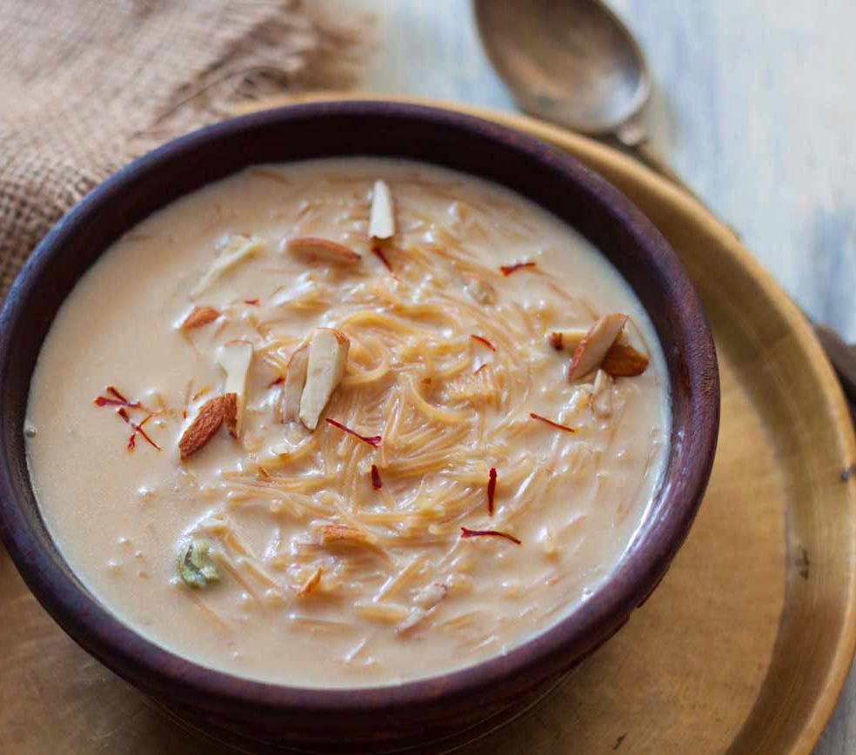
THANK YOU

